Slide 1
Umang Godhani
Topic Of Interest : From given study find which factor is more significant cause of Cholesterol.

Slide 2
Data Discription
The Framingham Heart Study is one of the longest running health studies. It has followed original subjects, their children, and their grand children, looking for factors that affect cardiac health. These data only include subjects whose cholesterol was measured in the first exam.

Slide 3
Purpose
In the study we will find the most significant factor for having high cholesterol.
We will also learn about the statistics of Age and Cholesterol levels.
We will be using multiple regression model to get our answers.
Histogram will be used to show the graphs.

Slide 4
Variables in data
SBP: Systolic blood pressure at first exam
DBP: Diastolic blood pressure at first exam
CHOL: Serum choloesterol at first exam
CIG: Number of cigarettes smoked/day at first exam
DEATH: First biannual exam missed due to death; 0=”alive at tenth biannual exam.” (This exam wasgiven in the 18th year of the study.) CAUSE: 0=aliv e at exam 10, 1=Coronary Heart Disease (sudden), 2=CHD (not sudden), 3=Stroke,4=Other cardiovascular disease, 5=cancer, 6=other

Slide 5
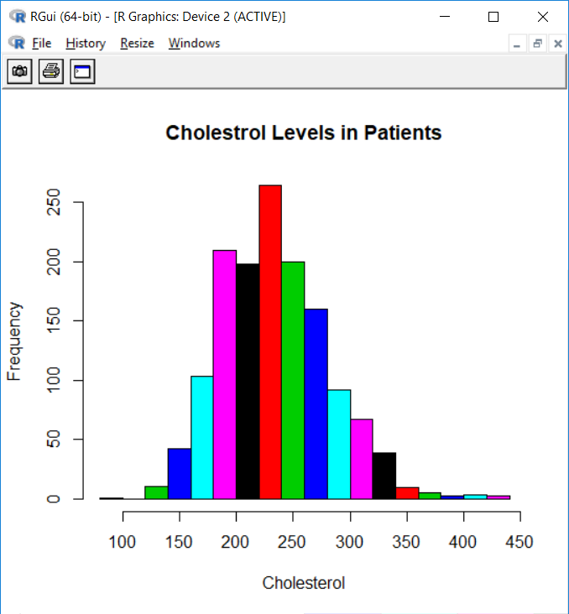
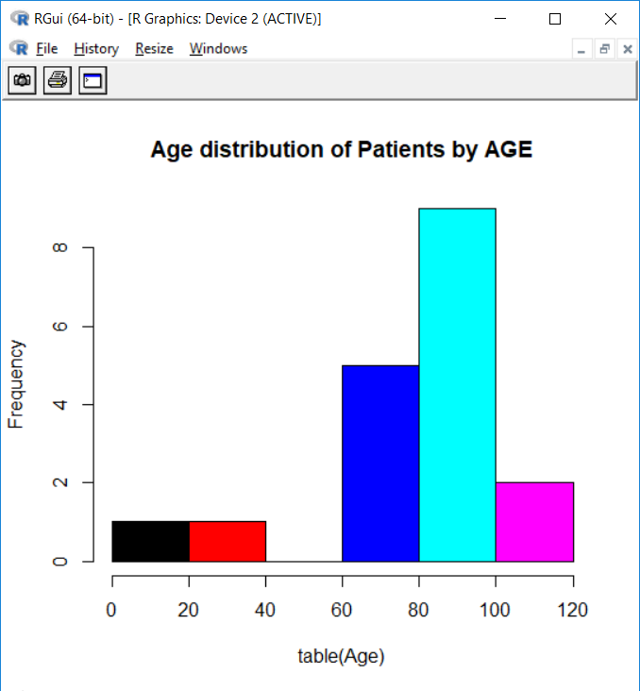
Information about the data
> hist(table(Age),col = c(1,2,3,4,5,6),main = "Age distribution of Patients by AGE")
> hist(Cholesterol,col = c(1,2,3,4,5,6),main = "Cholestrol Levels in Patients")

Slide 6
Methods used
By using R we used lm() function and used Cholesterol as our response variable since we want to know what factor is most significant for the Cholesterol levels.
We remove least significant variables one by one to come up with the variables that means the most to out study.

Slide 7
Multiple Linear Regression
> model = lm(Cholesterol~Age+Sex+SBP+DBP+CIG)
> model
Call:
lm(formula = Cholesterol ~ Age + Sex + SBP + DBP + CIG)
Coefficients:
(Intercept) Age SexMALE SBP DBP CIG
172.85555 0.78168 -17.63998 0.01716 0.28024 0.17267
Here shown how to set up the Multiple Regression model using “Cholesterol” as response variable.

Slide 8

Here shown the summary of our model which helps us define significance or our code by using Signif. Codes at the bottom. Using this process multiple time till removing the least relative variable each time leads us to the most significant variable.
> summary(model)
lm(formula = Cholesterol ~ Age + Sex + SBP + DBP + CIG)
Residuals:
Min 1Q Median 3Q Max
-130.473 -30.552 -3.035 27.983 189.586
Coefficients:
Estimate Std. Error t value Pr(>|t|)
(Intercept) 172.85555 15.52220 11.136 < 2e-16 ***
Age 0.78168 0.26271 2.975 0.00298 **
SexMALE -17.63998 2.67251 -6.601 5.8e-11 ***
SBP 0.01716 0.07319 0.234 0.81469
DBP 0.28024 0.14135 1.983 0.04761 *
CIG 0.17267 0.11510 1.500 0.13378
---
Signif. codes: 0 ‘***’ 0.001 ‘**’ 0.01 ‘*’ 0.05 ‘.’ 0.1 ‘ ’ 1

Slide 9
Conclusion
> summary(model3)
Call:
lm(formula = Cholesterol ~ SBP + DBP + CIG)
Residuals:
Min 1Q Median 3Q Max
-132.028 -31.542 -3.822 28.581 200.734
Coefficients:
Estimate Std. Error t value Pr(>|t|)
(Intercept) 203.37236 8.05512 25.248 <2e-16 ***
SBP 0.11810 0.07196 1.641 0.101
DBP 0.16722 0.14176 1.180 0.238
CIG -0.16191 0.10637 -1.522 0.128
---
Signif. codes: 0 ‘***’ 0.001 ‘**’ 0.01 ‘*’ 0.05 ‘.’ 0.1 ‘ ’ 1
After using methods shown and we conclude that SBP, DBP and CIG are the significant variables.
DBP (Diastolic blood pressure at first exam) is the most significant variable out of all variables.
Also all 3 variables have P value greater that 0.05 which is the proof of significance.

Slide 10
Source
“Statistical Methods in Epidemiology” by H.A.Kahn and C.T.Sempos

